Slide 1
Module 3: Software Testing and Quality (8 hrs) – Comprehension level
Introduction to Software Testing: verification and validation, Test Strategies for conventional Software, Validation Testing, White box Testing: Basis path testing, Black box Testing. Software Quality Assurance : Elements of software quality assurance, SQA Tasks, Goals and Metrics, Software configuration management : SCM process.

Slide 2

Software Testing Strategies
Contents
Software Testing
Verification and Validation
Testing Strategies
  Unit Testing
  Integration Testing
  System Testing
  Acceptance Testing
Manual and Automated Testing
Regression Testing
Smoke Testing
Dept. of CSE, SOE, Presidency University

Slide 3
Software Testing
Testing is the process of exercising a program with the specific intent of finding errors prior to delivery to the end user.
Dept. of CSE, SOE, Presidency University

Slide 4
Where are We?
Requirement
Analysis
Design
Implement
Evaluating the System
Test
Dept. of CSE, SOE, Presidency University

Slide 5
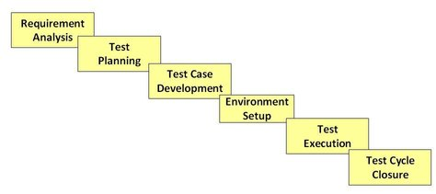
Software Testing Methodology
Dept. of CSE, SOE, Presidency University

Slide 6

What Testing Shows
errors
requirements conformance
performance
an indication
of quality
Dept. of CSE, SOE, Presidency University

Slide 7
Verification and Validation
Verification refers to the set of tasks that ensure that software correctly implements a specific function.
Validation refers to a different set of tasks that ensure that the software that has been built is traceable to customer requirements.
Boehm states this another way:
  Verification: "Are we building the product right?"
  Validation: "Are we building the right product?"
Dept. of CSE, SOE, Presidency University

Slide 8


Who Tests the Software
Developer
Independent Tester
Understands the system
Must learn about the system,
but, will test "gently"
but, will attempt to break it
and, is driven by "delivery"
and, is driven by quality
Dept. of CSE, SOE, Presidency University

Slide 9
Testing Strategy
System engineering
Analysis modeling
Design modeling
Code generation
Unit test
Integration test
Validation test
System test
Dept. of CSE, SOE, Presidency University

Slide 10
Testing Strategies
Unit testing - testing performed on each module or block of code during development. Unit Testing is normally done by the programmer who writes the code.
Integration testing - testing done before, during and after integration of a new module into the main software package. This involves testing of each individual code module. One piece of software can contain several modules which are often created by several different programmers. It is crucial to test each module's effect on the entire program model. Performed by professional testing team.
System testing - testing done by a professional testing team on the completed software product before it is introduced to the market.
Acceptance testing - beta testing of the product done by the end-users of the software.
Dept. of CSE, SOE, Presidency University

Slide 11


1. Unit Testing
module
to be
tested
results
software
engineer
test cases
Dept. of CSE, SOE, Presidency University

Slide 12
1. Unit Testing
module
to be
tested
interface
local data structures
boundary conditions
independent paths
error handling paths
test cases
Dept. of CSE, SOE, Presidency University

Slide 13

2. Integration Testing Strategies
Options:
  • the “big bang” approach
  • an incremental construction strategy
Dept. of CSE, SOE, Presidency University

Slide 14
Top Down Integration
A
top module is tested with
stubs
B
F
G
stubs are replaced one at
a time, "depth first"
C
as new modules are integrated,
some subset of tests is re-run
D
E
Dept. of CSE, SOE, Presidency University

Slide 15
Bottom-Up Integration
A
B
F
G
drivers are replaced one at a
time, "depth first"
C
worker modules are grouped into
builds and integrated
D
E
cluster
Dept. of CSE, SOE, Presidency University

Slide 16
Sandwich Testing
A
Top modules are
tested with stubs
B
F
G
C
builds and integrated
D
E
cluster
Dept. of CSE, SOE, Presidency University

Slide 17
3. System Testing
System Testing is a level of software testing where a complete and integrated software is tested. The purpose of this test is to evaluate the system's compliance with the specified requirements.
Dept. of CSE, SOE, Presidency University

Slide 18
4. Acceptance Testing
Acceptance Testing is a level of software testing where a system is tested for acceptability. The purpose of this test is to evaluate the system's compliance with the business requirements and assess whether it is acceptable for delivery.
Dept. of CSE, SOE, Presidency University

Slide 19
Manual and Automated Testing
  Unit testing, Integration testing, System testing and Acceptance testing can be performed either manually or in automated ways
Manual Testing | Automated Testing
Manual testing requires human intervention for test execution. | Automation Testing is use of tools to execute test cases
Manual testing will require skilled labour, long time & will imply high costs. | Automation Testing saves time, cost and manpower. Once recorded, it's easier to run an automated test suite
Any type of application can be tested manually, certain testing types like ad-hoc and monkey testing are more suited for manual execution. | Automated testing is recommended only for stable systems and is mostly used for System Testing
Manual testing can be become repetitive and boring. | The boring part of executing same test cases time and again, is handled by automation software in Automation Testing.
Dept. of CSE, SOE, Presidency University

Slide 20
Regression Testing
Regression testing is the re-execution of some subset of tests that have already been conducted to ensure that changes have not propagated unintended side effects
Whenever software is corrected, some aspect of the software configuration (the program, its documentation, or the data that support it) is changed.
Regression testing helps to ensure that changes (due to testing or for other reasons) do not introduce unintended behavior or additional errors.
Regression testing may be conducted manually, by re-executing a subset of all test cases or using automated capture/playback tools.
Dept. of CSE, SOE, Presidency University

Slide 21
Smoke Testing
A common approach for creating “daily builds” for product software
Smoke testing steps:
  Software components that have been translated into code are integrated into a “build.”
    A build includes all data files, libraries, reusable modules, and engineered components that are required to implement one or more product functions.
  A series of tests is designed to expose errors that will keep the build from properly performing its function.
    The intent should be to uncover “show stopper” errors that have the highest likelihood of throwing the software project behind schedule.
  The build is integrated with other builds and the entire product (in its current form) is smoke tested daily.
    The integration approach may be top down or bottom up.
Dept. of CSE, SOE, Presidency University

Slide 22
Black Box Testing (Functional Testing)
  Uses only the Specification document to identify test cases.
  Knowing the specified function a component has been designed for.
  Tests conducted at the interface of the component.
Set of Inputs
Set of Outputs
Black Box
Dept. of CSE, SOE, Presidency University

Slide 23
Black Box Testing
Advantages
  Independent of how the software is implemented.
  If implementation changes, test cases are still useful.
  Test case development can occur in parallel with the implementation.
Disadvantages:
  Redundancies may exist among test cases.
Dept. of CSE, SOE, Presidency University

Slide 24
White Box Testing (Structural Testing)
  Structural testing uses the programs source code (implementation) as the basis of test case identification.
  Requires knowledge of internal workings of a component.
  Test cases exercise specific sets of condition, loops, etc.
Advantages:
Provides more coverage in testing conditions and decisions.
Reveals hidden errors during coding.
Disadvantages:
Missed cases in the code are obviously missed during testing too.
In-depth knowledge of the programming language is needed.
Dept. of CSE, SOE, Presidency University

Slide 25
Test Case Design
  White Box
    Control Flow Graph
    Cyclomatic Complexity
    Basis Path Testing
  Black Box
    Equivalence Classes
    Boundary Value Analysis
Dept. of CSE, SOE, Presidency University

Slide 26
Introduction to White Box Testing
Test Engineers have access to the source code.
Typical at the Unit Test level as the programmers have knowledge of the internal logic of code.
Tests are based on coverage of:
  Code statements;
  Branches;
  Paths;
  Conditions.
Most of the testing techniques are based on Control Flow Graph (denoted as CFG) of a code fragment.
Dept. of CSE, SOE, Presidency University

Slide 27
Control Flow Graph
An abstract representation of a structured program/function/method.
Consists of two major components:
  Node:
    Represents a stretch of sequential code statements with no branches.
  Directed Edge (also called arc):
    Represents a branch, alternative path in execution.
Path:
  A collection of Nodes linked with Directed Edges.
Dept. of CSE, SOE, Presidency University

Slide 28
Simple Examples of CFG
Statement1;
Statement2;
Statement3;
Statement4;
Can be represented as one node as there is no branch.
1
CFG
Statement1;
Statement2;
if X < 10 then
Statement3;
else
Statement4;
1
T
3
1
2
2
3
F
4
CFG
4
Dept. of CSE, SOE, Presidency University

Slide 29
More Examples of CFG
if X > 0 then
Statement1;
else
Statement2;
1
T
2
2
1
4
3
3
F
CFG
F
while X < 10 {
Statement1;
X++; }
1
2
1
2
3
4
T
3
CFG
Dept. of CSE, SOE, Presidency University

Slide 30
Notation Guide for CFG
A CFG should have:
  1 entry arc (known as a directed edge, too).
  1 exit arc.
All nodes should have:
  At least 1 entry arc.
  At least 1 exit arc.
A Logical Node that does not represent any actual statements, can be added as a joining point for several incoming edges.
  Represents a logical closure.
  Example:
    Node 4 in the if-then-else example from previous slide.
Dept. of CSE, SOE, Presidency University

Slide 31
Example: Minimum Element
min = A[0];
I = 1;
while (I < N) {
if (A[I] < min)
min = A[I];
I = I + 1;
}
print min
1
1
2
2
F
T
3
3
4
F
T
5
5
4
6
6
CFG
Dept. of CSE, SOE, Presidency University

Slide 32
Number of Paths through CFG
Given a program, how do we exercise all statements and branches at least once?
Translating the program into a CFG, an equivalent question is:
  Given a CFG, how do we cover all arcs and nodes at least once?
Since a path is a trail of nodes linked by arcs, this is similar to ask:
  Given a CFG, what is the set of paths that can cover all arcs and nodes?
Dept. of CSE, SOE, Presidency University

Slide 33
Number of Paths through CFG – Example
T
3
1
2
1
F
4
CFG
CFG
Only one path is needed: [ 1 ]
Two paths are needed:
  [ 1 – 2 – 4 ]
  [ 1 – 2 – 3 – 4 ]
T
2
1
4
Two paths are needed:
  [ 1 – 2 – 4 ]
  [ 1 – 3 – 4 ]
3
F
CFG
Dept. of CSE, SOE, Presidency University

Slide 34
Basis Path Testing
Path Testing: Testing designed to execute all or selected paths through a computer program.
Branch Testing: Testing designed to execute each outcome of each decision point in a computer program.
Basis Path Testing: is a hybrid between path testing and branch testing. It fulfills the requirements of branch testing & also tests all of the independent paths that could be used to construct any arbitrary path through the computer program
Dept. of CSE, SOE, Presidency University

Slide 35
Basis Path Testing
A generalized technique to find out the number of paths needed (known as “cyclomatic complexity”) to cover all arcs and nodes in CFG.
Steps:
  Draw the CFG for the code fragment.
  Compute the cyclomatic complexity number C, for the CFG.
  Find at most C paths that cover the nodes and arcs in a CFG, also known as Basis Paths Set.
  Design test cases to force execution along paths in the Basis Paths Set.
Dept. of CSE, SOE, Presidency University

Slide 36
Step 1 – Draw CFG
min = A[0];
I = 1;
while (I < N) {
if (A[I] < min)
min = A[I];
I = I + 1;
}
print min
1
2
F
T
3
F
T
5
4
6
CFG
Dept. of CSE, SOE, Presidency University

Slide 37
Step 2 – Compute Cyclomatic Complexity
1
Cyclomatic complexity =
  The number of ‘regions’ in the graph;
  OR
  The number of predicates + 1.
2
F
T
3
F
T
5
4
6
CFG
Dept. of CSE, SOE, Presidency University

Slide 38
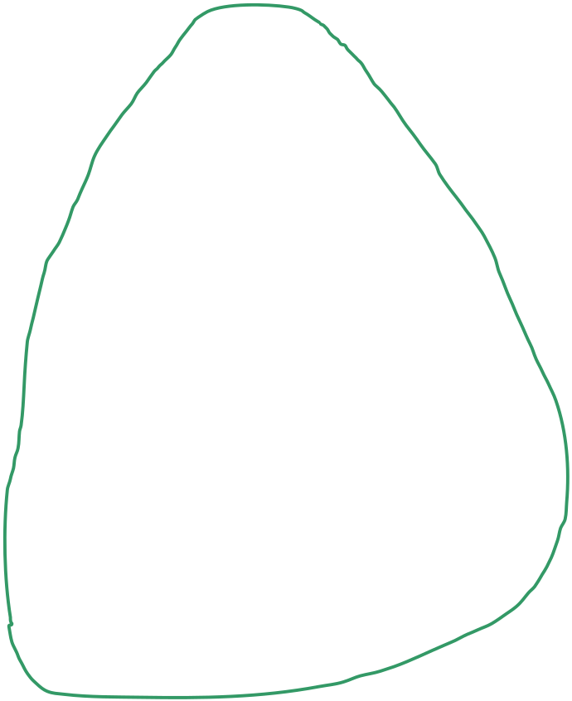


Step 2 – Compute Cyclomatic Complexity
1
Region: Enclosed area in the CFG.
  Do not forget the outermost region.
In this example:
  3 Regions (see the circles with different colors).
  Cyclomatic Complexity = 3
Alternative way in next slide.
2
F
T
3
F
T
5
4
6
CFG
Dept. of CSE, SOE, Presidency University

Slide 39
Step 2 – Compute Cyclomatic Complexity
Predicates:
  Nodes with multiple exit arcs.
  Corresponds to branch/conditional statement in program.
In this example:
  Predicates = 2
    (Node 2 and 3)
  Cyclomatic Complexity
  = 2 + 1
  = 3
1
2
F
T
3
F
T
5
4
6
CFG

Slide 40
Step 3 – Find Basis Path Set
Independent path:
  An executable or realizable path through the graph from the start node to the end node that has not been traversed before.
  Must move along at least one arc that has not been yet traversed (an unvisited arc).
  The objective is to cover all statements in a program by independent paths.
The number of independent paths to discover
<= cyclomatic complexity number.
Decide the Basis Path Set:
  It is the maximal set of independent paths in the flow graph.
  NOT a unique set.

Slide 41
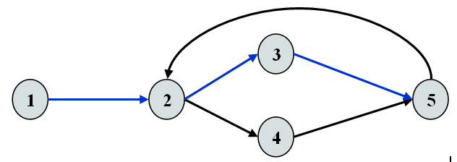
Step 3 – Example
1-2-3-5 can be the first independent path; 1-2-4-5 is another; 1-2-3-5-2-4-5 is one more.
There are only these 3 independent paths. The basis path set is then having 3 paths.
Alternatively, if we had identified 1-2-3-5-2-4-5 as the first independent path, there would be no more independent paths.
The number of independent paths therefore can vary according to the order we identify them.

Slide 42
Step 3
Cyclomatic complexity = 3.
Need at most 3 independent paths to cover the CFG.
In this example:
  [ 1 – 2 – 6 ]
  [ 1 – 2 – 3 – 5 – 2 – 6 ]
  [ 1 – 2 – 3 – 4 – 5 – 2 – 6]
1
2
F
T
3
F
T
5
4
6
CFG

Slide 43
Step 4 – Design Test Cases
Prepare a test case for each independent path.
In this example:
  Path: [ 1 – 2 – 6 ]
    Test Case: A = { 5, …}, N = 1
    Expected Output: 5
  Path: [ 1 – 2 – 3 – 5 – 2 – 6 ]
    Test Case: A = { 5, 9, … }, N = 2
    Expected Output: 5
  Path: [ 1 – 2 – 3 – 4 – 5 – 2 – 6]
    Test Case: A = { 8, 6, … }, N = 2
    Expected Output: 6
These tests will result a complete decision and statement coverage of the code.

Slide 44
Another Example
int average (int[ ] value, int min, int max, int N) {
int i, totalValid, sum, mean;
i = totalValid = sum = 0;
while ( i < N && value[i] != -999 ) {
if (value[i] >= min && value[i] <= max){
totalValid += 1; sum += value[i];
}
i += 1;
}
if (totalValid > 0)
mean = sum / totalValid;
else
mean = -999;
return mean;
}

Slide 45
Step 1: Draw CFG
int average (int[ ] value, int min, int max, int N) {
int i, totalValid, sum, mean;
i = totalValid = sum = 0;
while ( i < N && value[i] != -999 ) {
if (value[i] >= min && value[i] <= max){
totalValid += 1; sum += value[i];
}
i += 1;
}
if (totalValid > 0)
mean = sum / totalValid;
else
mean = -999;
return mean;
}
1
2
4
3
5
6
7
8
9
10
11

Slide 46
Step 1: Draw CFG
9
T
8
11
F
F
10
F
1
2
T
3
T
4
T
5
T
6
F
F
7
CFG

Slide 47
Step 2: Find Cyclomatic Complexity
9
T
8
11
F
F
10
F
1
2
T
3
T
4
T
5
T
6
F
F
Regions = 6
Cyclomatic Complexity = 6
7
CFG

Slide 48
Step 2: Find Cyclomatic Complexity
9
T
8
11
F
F
10
F
1
2
T
3
T
4
T
5
T
6
F
F
Predicates = 5
Cyclomatic Complexity
= 5 + 1
= 6
7
CFG

Slide 49
Step 3: Find Basis Path Set
Find at most 6 independent paths.
Usually, simpler path == easier to find a test case.
However, some of the simpler paths are not possible (not realizable):
  Example: [ 1 – 2 – 8 – 9 – 11 ].
    Not Realizable (i.e., impossible in execution).
    Verify this by tracing the code.
Basic Path Set:
  [ 1 – 2 – 8 – 10 – 11 ].
  [ 1 – 2 – 3 – 8 – 10 – 11 ].
  [ 1 – 2 – 3 – 4 – 7 – 2 – 8 – 10 – 11 ].
  [ 1 – 2 – 3 – 4 – 5 – 7 – 2 – 8 – 10 – 11 ].
  [ 1 – ( 2 – 3 – 4 – 5 – 6 – 7 ) – 2 – 8 – 9 – 11].
In the last case, ( … ) represents possible repetition.

Slide 50
Step 4: Derive Test Cases
Path:
  [ 1 – 2 – 8 – 10 – 11 ]
Test Case:
  value = {…} irrelevant.
  N = 0
  min, max irrelevant.
Expected Output:
  average = -999
... i = 0;
while (i < N &&
value[i] != -999) {
......
}
if (totalValid > 0)
......
else
mean = -999;
return mean;
1
2
8
10
11

Slide 51
Step 4: Derive Test Cases
Path:
  [ 1 – 2 – 3 – 8 – 10 – 11]
Test Case:
  value = {-999}
  N = 1
  min, max irrelevant
Expected Output:
  average = -999
... i = 0;
while (i < N &&
value[i] != -999) {
......
}
if (totalValid > 0)
......
else
mean = -999;
return mean;
1
2
3
8
10
11

Slide 52
Step 4: Derive Test Cases
Path:
  [ 1 – 2 – 3 – 4 – 7 – 2 – 8 – 10 – 11 ]
Test Case:
  A single value in the value[ ] array which is smaller than min.
  value = { 25 }, N = 1, min = 30, max irrelevant.
Expected Output:
  average = -999
Path:
  [ 1 – 2 – 3 – 4 – 5 – 7 – 2 – 8 – 10 – 11 ]
Test Case:
  A single value in the value[ ] array which is larger than max.
  value = { 99 }, N = 1, max = 90, min irrelevant.
Expected Output:
  average = -999

Slide 53
Step 4: Derive Test Cases
Path:
  [ 1 – 2 – 3 – 4 – 5 – 6 – 7 – 2 – 8 – 9 – 11 ]
Test Case:
  A single valid value in the value[ ] array.
  value = { 25 }, N = 1, min = 0, max = 100
Expected Output:
  average = 25
Path:
  [ 1 – 2 – 3 – 4 – 5 – 6 – 7 – 2 – 3 – 4 – 5 – 6 – 7 – 2 – 8 – 9 – 11 ]
Test Case:
  Multiple valid values in the value[ ] array.
  value = { 25, 75 }, N = 2, min = 0, max = 100
Expected Output:
  average = 50

Slide 54
Case Studies
  Write code fragments for Binary Search and Bubble Sort programs and perform “Basis Path Testing” by doing the following:
  1. Draw the CFG for the code fragment.
  2. Compute the cyclomatic complexity number for the CFG.
  3. Find the Basis Paths Set.
  4. Design test cases along paths in the Basis Paths Set.

Slide 55
Summary of Basis Path Testing
A simple test that:
  Cover all statements.
  Exercise all decisions (conditions).
The cyclomatic complexity is an upperbound of the independent paths needed to cover the CFG.
  If more paths are needed, then either cyclomatic complexity is wrong, or the paths chosen are incorrect.
Although picking a complicated path that covers more than one unvisited edge is possible all times, it is not encouraged:
  May be hard to design the test case.

Slide 56
Black Box Testing
Test Engineers have no access to the source code or documentation of internal working.
The “Black Box” can be:
  A single unit.
  A subsystem.
  The whole system.
Tests are based on:
  Specification of the “Black Box”.
  Providing inputs to the “Black Box” and inspect the outputs.
Inputs
Component Under Test
Outputs

Slide 57
Black Box Testing
Two techniques will be covered for the black box testing in this course:
  Equivalence Partition;
  Boundary Value Analysis.

Slide 58
Equivalence Partition
To ensure the correct behavior of a “black box”, both valid and invalid cases need to be tested.
Example:
  Given the method below:
boolean isValidMonth(int m)
Functionality: check m is [1..12]
Output:
- true if m is 1 to 12
- false otherwise
Is there a better way to test other than testing all integer values [-2³¹, …, 2³¹-1] ?

Slide 59
Equivalence Partition
Observations:
  For a method, it is common to have a number of inputs that produce similar outcomes.
  Testing one of the inputs should be as good as exhaustively testing all of them.
  So, pick only a few test cases from each “category” of input that produce the same output.
1, 5, 9,
11, 12
isValidMonth( int m )
TRUE
All inputs here produce TRUE.

Slide 60
Equivalence Partition
Partition input data into equivalence classes.
Data in each equivalence class:
  Likely to be treated equally by a reasonable algorithm.
  Produce same output state, i.e., valid/invalid.
Derive test data for each class.
Input Test Data
Component
Result

Slide 61
Example isValid(Month)
For the is ValidMonth example:
  Input value [1 … 12] should get a similar treatment.
  Input values lesser than 1, larger than 12 are two other groups.
Three partitions:
  [ -∞ ... 0 ] should produce an invalid result
  [ 1 … 12 ] should produce a valid result
  [ 13 … ∞ ] should produce an invalid result
Pick one value from each partition as test case:
  E.g., {-12, 5, 15}
  Reduce the number of test cases significantly.

Slide 62
Example - 2
Problem statement for Triangle Problem
The program reads three input numbers that represent the lengths of the three sides of a triangle. Based on these three input values, the program determines whether the triangle is scalene (that is, it has three unequal sides), isosceles (two equal sides), or equilateral (three equal sides). The program displays the result on the screen.

Slide 63
Triangle Problem
Input: Three integers a, b, c which represent the sides of a triangle.
Output: Type of triangle: “Equilateral”, “Isosceles”, “Scalene”, or “Not a Triangle”.
The integers must satisfy the following conditions:
C1: a<b+c
C2: b<a+c
C3: c<a+b
If all three sides are equal -> Equilateral triangle
If exactly one pair of sides are equal -> Isosceles triangle
No pair of sides are equal -> Scalene triangle
If conditions C1 or C2 or C3 fails -> Not a Triangle

Slide 64
Triangle Problem
Example: High-level classes for the Triangle Problem:
Class 1: Equilateral Triangle. Test case is triple (5,5,5)
Class 2: Isosceles Triangle. Test case is triple (5,5,6)
Class 3: Scalene Triangle. Test case is triple (5,6,7)
Class 4: Not a Triangle. Test case is triple (3,15,11)

Slide 65
Boundary Value Analysis
It has been found that most errors are caught at the boundary of the equivalence classes.
Not surprising, as the end points of the boundary are usually used in the code for checking:
  E.g., checking K is in range [ X … Y ):
Easy to make mistake on the comparison.
if (K >= X && K <= Y)
    ...

Slide 66
Using Boundary Value Analysis
If the component specifies a range, [ X … Y ]
  Four values should be tested:
    Valid: X and Y
    Invalid: Just below X (e.g., X – 1)
    Invalid: Just above Y (e.g., Y + 1)
  E.g., [1 … 12]
    Test Data: {0, 1, 12, 13}
Similar for open interval (X … Y), i.e., X and Y not inclusive.
  Four values should be tested:
    Invalid: X and Y
    Valid: Just above X (e.g., X + 1)
    Valid: Just below Y (e.g., Y - 1)
  E.g., (100 … 200)
    Test Data: {100, 101, 199, 200}

Slide 67
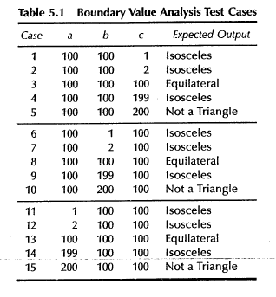
Boundary Value Test Cases for Triangle Problem
Triangle Side boundary conditions:
Each side between 1 and 200
A, B, C sides are taking values alternatively, while other two sides are having nominal values
Min (1)
Min+1 (2)
Nominal (100)
Max-1 (199)
Max (200)

Slide 68
Example 1 - Searching
boolean Search(
List aList, int key)
Precondition:
-aList has at least one element
Postcondition:
- true if key is in the aList
- false if key is not in aList

Slide 69
Equivalence Classes for Search
Sequence with a single value:
  key found.
  key not found.
Sequence of multi values:
  key found:
    First element in sequence.
    Last element in sequence.
    “Middle” element in sequence.
  key not found.

Slide 70
Test Data for Search
Test Case | aList | Key | Expected Result
1 | [ 123 ] | 123 | True
2 | [ 123 ] | 456 | False
3 | [ 1, 6, 3, -4, 5 ] | 1 | True
4 | [ 1, 6, 3, -4, 5 ] | 5 | True
5 | [ 1, 6, 3, -4, 5 ] | 3 | True
6 | [ 1, 6, 3, -4, 5 ] | 123 | False

Slide 71
Example 2 – Simple Shopping Scenario
Let us consider a simple shopping scenario -
Shop for $1000 and get 5% discount
Shop for $2000 and get 7% discount
Shop for $3000 and above and get 10% discount.

Slide 72
Example 2 – Simple Shopping Scenario
Equivalence partitioning - We can divide the input into four partitions, amount<0, 0 to 1000, 1001 to 2000, 2001 to 3000 and then 3001 and above.
We will keep things simple for now and will not go into details like the max amount one can shop for, or what about cents and all that stuff.
Adding the flavor of boundary value to the above partitions - the boundary values would be 0, 1000, 1001, 2000, 2001, 3000 and 3001. In boundary value analysis, immediate upper and lower values too are recommended to be tested, so we will include -1, 1 and 999. These are the values that can tell behavior the software for almost entire range of input values, but there can be other issues in software. For that reason, other input values too can be considered.

Slide 73
Example 3 – Quadratic Equation
For example, suppose we are testing a function that uses the quadratic formula to determine the two roots of a second-degree polynomial ax²+bx+c. For simplicity, assume that we are going to work only with real numbers, and print an error message if it turns out that the two roots are complex numbers (numbers involving the square root of a negative number).
We can come up with test data for each of the four cases, based on values of the polynomial's discriminant (b²-4ac).

Slide 74
Example 3 – Quadratic Equation
Easy data (discriminant is a perfect square)
Typical data (discriminant is positive):
a | b | c | Roots
1 | 2 | 1 | -1, -1
1 | 3 | 2 | -1, -2
a | b | c | Roots
1 | 4 | 1 | -3.73205, -0.267949
2 | 4 | 1 | -1.70711, -0.292893

Slide 75
Example 3 – Quadratic Equation
Boundary / extreme data (discriminant is zero):
a | b | c | Roots
1 | 1 | 1 | square root of negative number
0 | 1 | 1 | division by zero
Bogus data (discriminant is negative, or a is zero):
a | b | c | Roots
2 | -4 | 2 | 1, 1
2 | -8 | 8 | 2, 2

Slide 76
Example 4 – Factorial of n: n!
Equivalence partitioning – break the input domain into different classes:
  Class1: n<0
  Class2: n>0 and n! doesn’t cause an overflow
  Class3: n>0 and n! causes an overflow
Boundary Value Analysis:
  n=0 (between class1 and class2)

Slide 77
Factorial of n: n!
Test Cases
Test case = ( ins, expected outs)
Equivalence partitioning – break the input domain into different classes:
  From Class1: ((n = -1), “ function not defined for n negative”)
  From Class2: ((n = 3), 6)
  From Class3: ((n=100), “ input value too big”)
Boundary Value Analysis:
  ((n=0), 1)

